Slide 1
Process Synchronization

Slide 2
Background
Processes can execute concurrently
May be interrupted at any time, partially completing execution
Concurrent access to shared data may result in data inconsistency
Maintaining data consistency requires mechanisms to ensure the orderly execution of cooperating processes
Illustration of the problem: Suppose that we wanted to provide a solution to the consumer-producer problem that fills all the buffers. We can do so by having an integer counter that keeps track of the number of full buffers. Initially, counter is set to 0. It is incremented by the producer after it produces a new buffer and is decremented by the consumer after it consumes a buffer.

Slide 3
Producer
while (true) { /* produce an item in next produced */
while (counter == BUFFER_SIZE) ;
/* do nothing */
buffer[in] = next_produced;
in = (in + 1) % BUFFER_SIZE;
counter++;
}

Slide 4
Consumer
while (true) {
while (counter == 0)
; /* do nothing */
next_consumed = buffer[out];
out = (out + 1) % BUFFER_SIZE;
counter--;
/* consume the item in next consumed */
}

Slide 5
Race Condition
counter++ could be implemented as register1 = counter register1 = register1 + 1 counter = register1
counter-- could be implemented as register2 = counter register2 = register2 - 1 counter = register2
Consider this execution interleaving with “count = 5” initially:
S0: producer execute register1 = counter {register1 = 5} S1: producer execute register1 = register1 + 1 {register1 = 6} S2: consumer execute register2 = counter {register2 = 5} S3: consumer execute register2 = register2 – 1 {register2 = 4} S4: producer execute counter = register1 {counter = 6 } S5: consumer execute counter = register2 {counter = 4}

Slide 6
Critical Section Problem
Consider system of n processes {p₀, p₁, … p_{n-1}}
Each process has critical section segment of code
Process may be changing common variables, updating table, writing file, etc
When one process in critical section, no other may be in its critical section
Critical section problem is to design protocol to solve this
Each process must ask permission to enter critical section in entry section, may follow critical section with exit section, then remainder section

Slide 7
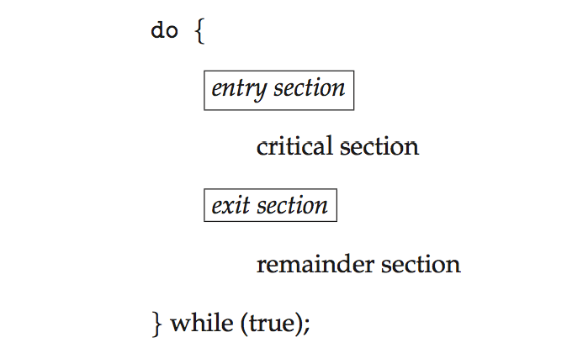
Critical Section
General structure of process P_{i}

Slide 8
Synchronization Hardware
Many systems provide hardware support for implementing the critical section code.
All solutions below based on idea of locking
Protecting critical regions via locks
Uniprocessors – could disable interrupts
Currently running code would execute without preemption
Generally too inefficient on multiprocessor systems
Operating systems using this not broadly scalable
Modern machines provide special atomic hardware instructions
Atomic = non-interruptible
Either test memory word and set value
Or swap contents of two memory words

Slide 9
Solution to Critical-section Problem Using Locks
do {
acquire lock
critical section
release lock
remainder section
} while (TRUE);

Slide 10
Mutex Locks
Previous solutions are complicated and generally inaccessible to application programmers
OS designers build software tools to solve critical section problem
Simplest is mutex lock
Protect a critical section by first acquire() a lock then release() the lock
Boolean variable indicating if lock is available or not
Calls to acquire() and release() must be atomic
Usually implemented via hardware atomic instructions
But this solution requires busy waiting
This lock therefore called a spinlock

Slide 11
acquire() and release()
acquire() { while (!available)
; /* busy wait */
available = false;;
}
release() {
available = true;
}
do {
acquire lock
critical section
release lock
remainder section
} while (true);

Slide 12
Semaphore
Synchronization tool that provides more sophisticated ways (than Mutex locks) for process to synchronize their activities.
Semaphore S – integer variable
Can only be accessed via two indivisible (atomic) operations
wait() and signal()
Originally called P() and V()
Definition of the wait() operation
wait(S) {
while (S <= 0)
; // busy wait
S--;
}
Definition of the signal() operation
signal(S) {
S++;
}

Slide 13
Semaphore Usage
Counting semaphore – integer value can range over an unrestricted domain
Binary semaphore – integer value can range only between 0 and 1
Same as a mutex lock
Can solve various synchronization problems
Consider P₁ and P₂ that require S₁ to happen before S₂
Create a semaphore “synch” initialized to 0
P1:
S₁;
signal(synch);
P2:
wait(synch);
S₂;
Can implement a counting semaphore S as a binary semaphore

Slide 14
Semaphore Implementation
Must guarantee that no two processes can execute the wait() and signal() on the same semaphore at the same time
Thus, the implementation becomes the critical section problem where the wait and signal code are placed in the critical section
Could now have busy waiting in critical section implementation
But implementation code is short
Little busy waiting if critical section rarely occupied
Note that applications may spend lots of time in critical sections and therefore this is not a good solution

Slide 15
Semaphore Implementation with no Busy waiting
With each semaphore there is an associated waiting queue
Each entry in a waiting queue has two data items:
value (of type integer)
pointer to next record in the list
Two operations:
block – place the process invoking the operation on the appropriate waiting queue
wakeup – remove one of processes in the waiting queue and place it in the ready queue
typedef struct{
int value;
struct process *list;
} semaphore;

Slide 16
Implementation with no Busy waiting (Cont.)
wait(semaphore *S) {
S->value--;
if (S->value < 0) { add this process to S->list;
block();
}
}
signal(semaphore *S) {
S->value++;
if (S->value <= 0) { remove a process P from S->list;
wakeup(P);
}
}

Slide 17
Deadlock and Starvation
Deadlock – two or more processes are waiting indefinitely for an event that can be caused by only one of the waiting processes
Let S and Q be two semaphores initialized to 1
P₀ P₁
wait(S); wait(Q);
wait(Q); wait(S);
... ...
signal(S); signal(Q);
signal(Q); signal(S);
Starvation – indefinite blocking
A process may never be removed from the semaphore queue in which it is suspended
Priority Inversion – Scheduling problem when lower-priority process holds a lock needed by higher-priority process
Solved via priority-inheritance protocol

Slide 18
Classical Problems of Synchronization
Classical problems used to test newly-proposed synchronization schemes
Bounded-Buffer Problem
Readers and Writers Problem
Dining-Philosophers Problem

Slide 19
Bounded-Buffer Problem
n buffers, each can hold one item
Semaphore mutex initialized to the value 1
Semaphore full initialized to the value 0
Semaphore empty initialized to the value n

Slide 20
Bounded Buffer Problem (Cont.)
The structure of the producer process
do {
... /* produce an item in next_produced */
...
wait(empty);
wait(mutex);
... /* add next produced to the buffer */
...
signal(mutex);
signal(full);
} while (true);

Slide 21
Bounded Buffer Problem (Cont.)
The structure of the consumer process
Do {
wait(full);
wait(mutex);
... /* remove an item from buffer to next_consumed */
...
signal(mutex);
signal(empty);
... /* consume the item in next consumed */
... } while (true);

Slide 22
Readers-Writers Problem
A data set is shared among a number of concurrent processes
Readers – only read the data set; they do not perform any updates
Writers – can both read and write
Problem – allow multiple readers to read at the same time
Only one single writer can access the shared data at the same time
Several variations of how readers and writers are considered – all involve some form of priorities
Shared Data
Data set
Semaphore rw_mutex initialized to 1
Semaphore mutex initialized to 1
Integer read_count initialized to 0

Slide 23
Readers-Writers Problem (Cont.)
The structure of a writer process
do { wait(rw_mutex);
... /* writing is performed */
...
signal(rw_mutex);
} while (true);

Slide 24
Readers-Writers Problem (Cont.)
The structure of a reader process
do { wait(mutex); read_count++; if (read_count == 1)
wait(rw_mutex);
signal(mutex);
... /* reading is performed */
...
wait(mutex); read count--; if (read_count == 0)
signal(rw_mutex);
signal(mutex);
} while (true);

Slide 25
Readers-Writers Problem Variations
First variation – no reader kept waiting unless writer has permission to use shared object
Second variation – once writer is ready, it performs the write ASAP
Both may have starvation leading to even more variations
Problem is solved on some systems by kernel providing reader-writer locks

Slide 26
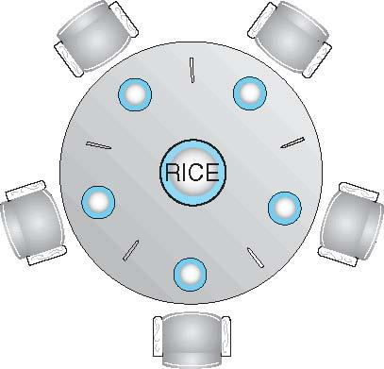
Dining-Philosophers Problem
Philosophers spend their lives alternating thinking and eating
Don’t interact with their neighbors, occasionally try to pick up 2 chopsticks (one at a time) to eat from bowl
Need both to eat, then release both when done
In the case of 5 philosophers
Shared data
Bowl of rice (data set)
Semaphore chopstick [5] initialized to 1

Slide 27
Dining-Philosophers Problem Algorithm
The structure of Philosopher i:
do {
wait (chopstick[i] );
wait (chopStick[ (i + 1) % 5] );
// eat
signal (chopstick[i] );
signal (chopstick[ (i + 1) % 5] );
// think
} while (TRUE);
What is the problem with this algorithm?

Slide 28
Dining-Philosophers Problem Algorithm (Cont.)
Deadlock handling
Allow at most 4 philosophers to be sitting simultaneously at the table.
Allow a philosopher to pick up the forks only if both are available (picking must be done in a critical section.
Use an asymmetric solution -- an odd-numbered philosopher picks up first the left chopstick and then the right chopstick. Even-numbered philosopher picks up first the right chopstick and then the left chopstick.

Slide 29
Problems with Semaphores
Incorrect use of semaphore operations:
signal (mutex) …. wait (mutex)
wait (mutex) … wait (mutex)
Omitting of wait (mutex) or signal (mutex) (or both)
Deadlock and starvation are possible.

Slide 30
Linux Synchronization
Linux:
Prior to kernel Version 2.6, disables interrupts to implement short critical sections
Version 2.6 and later, fully preemptive
Linux provides:
Semaphores
atomic integers
spinlocks
reader-writer versions of both
On single-cpu system, spinlocks replaced by enabling and disabling kernel preemption

Slide 31
Pthreads Synchronization
Pthreads API is OS-independent
It provides:
mutex locks
condition variable
Non-portable extensions include:
read-write locks
spinlocks

Slide 32
OpenMP Synchronization
OpenMP is a set of compiler directives and API that support parallel progamming.
void update(int value)
{
#pragma omp critical
{
count += value
}
}
The code contained within the #pragma omp critical directive is treated as a critical section and performed atomically.

